Slide 1
Introduction to Deep Learning
The slides are mostly adopted from material developed by:
Dr. Aiman El-Maleh, KFUPM, COE Department

Slide 2
Outline
Artificial Neural Networks
The Soft Perceptron
MLPs as Boolean Functions
MLPs as Universal Classifiers

Slide 3
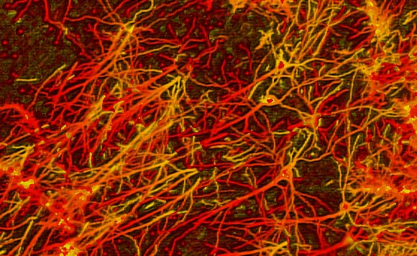
Neural Computation
Neural Computation is a general Machine Learning approach that involves processing information in a similar manner to the networks of neurons (i.e. Neural Networks) found in human/animal brains
Artificial Neural Networks (ANNs) are networks of Artificial Neurons, and hence constitute crude approximations to parts of real brains
They are massively parallel, which makes them efficient, robust, fault and noise tolerant

Slide 4
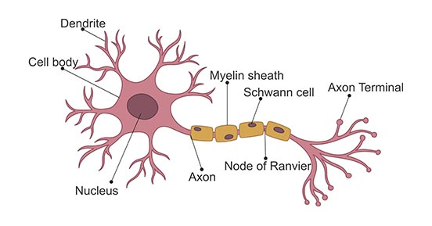
Artificial Neural Networks (ANNs)
A biological neuron highlights:
Signals come in through the dendrites into the Soma
A signal goes out via the axon to other neurons
Neurons are connected and receive electrical signals from other neurons
Neurons process input signals and can be activated
Soma (Cell Body)
Single Neuron

Slide 5
Artificial Neural Networks (ANNs)
Mathematical model for learning inspired by biological neural networks
Model mathematical function from inputs to outputs based on the structure and parameters of the network
Allows for learning the network's parameters based on data
Neural networks have become one of the major thrust areas recently in various AI tasks including pattern recognition, prediction, and analysis problems
In many problems they have established the state of the art, often exceeding previous benchmarks by large margins

Slide 6
Mathematically Modeling of a single neuron
We can model a single neuron mathematically loosely by using a perceptron as shown below:
Artificial
Direction of the signal

Slide 7

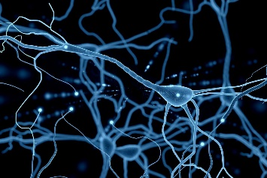
Artificial Neural Networks (ANNs)
Neural nets are composed of networks of neurons called perceptrons
Notes:
Perceptron is a mathematical representation of a biological neuron.​

Slide 8
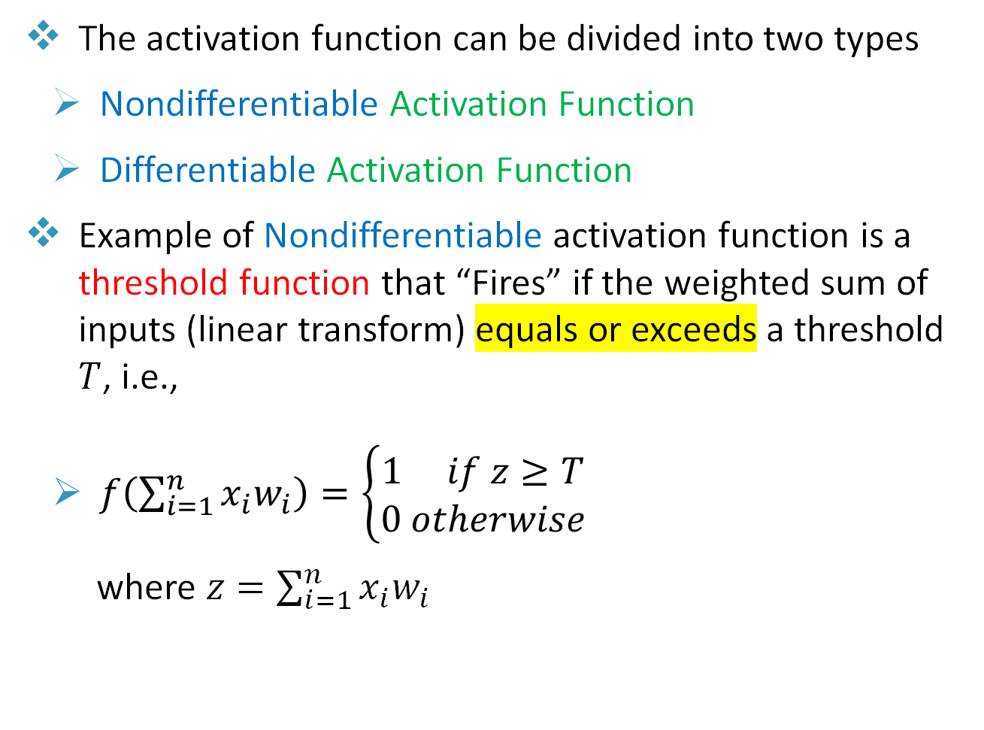
The Perceptron
The activation function can be divided into two types
Nondifferentiable Activation Function
Differentiable Activation Function
Example of Nondifferentiable activation function is a threshold function that “Fires” if the weighted sum of inputs (linear transform) equals or exceeds a threshold $T$, i.e.,
$f\left(\sum_{i=1}^{n}{x_{i}w_{i}}\right)=\left\{\begin{matrix}1 if z≥T \\ 0 otherwise\end{matrix}\right.$
where $z=\sum_{i=1}^{n}{x_{i}w_{i}}$
Notes:
A perceptron can be referred to as a single-layer artificial neural network.

Slide 9
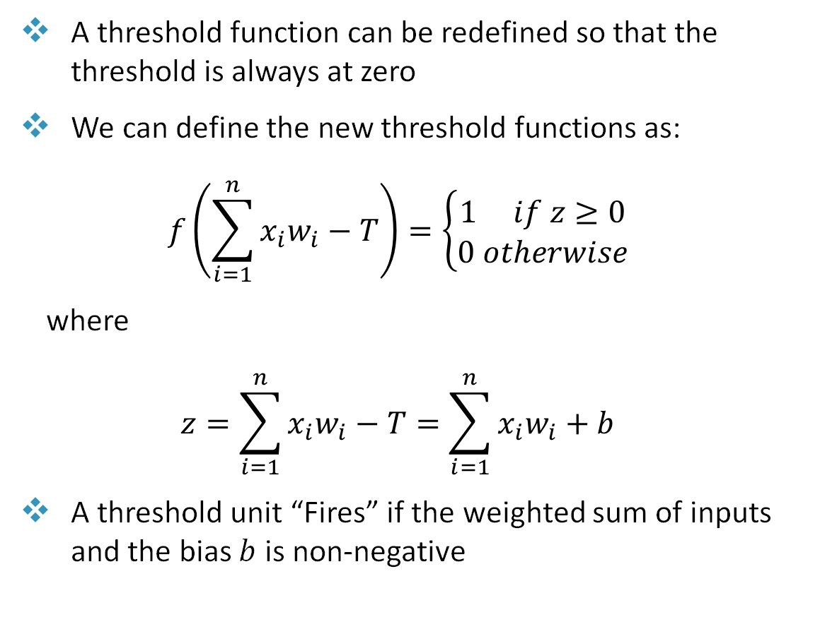
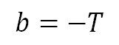


The Perceptron
A threshold function can be redefined so that the threshold is always at zero
We can define the new threshold functions as:
$$f\left(\sum_{i=1}^{n}{x_{i}w_{i}−T}\right)=\left\{\begin{matrix}1 if z≥0 \\ 0 otherwise\end{matrix}\right.$$
where
$$z=\sum_{i=1}^{n}{x_{i}w_{i}}−T=\sum_{i=1}^{n}{x_{i}w_{i}}+b$$
A threshold unit “Fires” if the weighted sum of inputs and the bias $b$ is non-negative
$$T$$
$$≡$$
$$b=−T$$

Slide 10

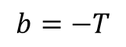


The Perceptron
$$T$$
$$≡$$
$$b=−T$$

Slide 11
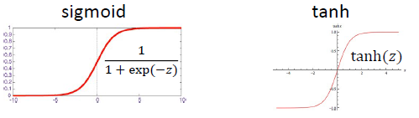
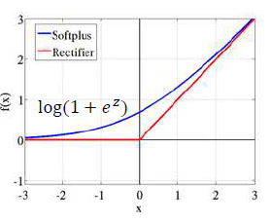
The “Soft” Perceptron
Differentiable Activation Functions are often non-linear
The Activation Function is used at the output which normalizes the output to a range of values and helps the network learn complex data
Examples of such functions are:
Sigmoid
tanh
Softplus
Rectifier(Relu)
…

Slide 12
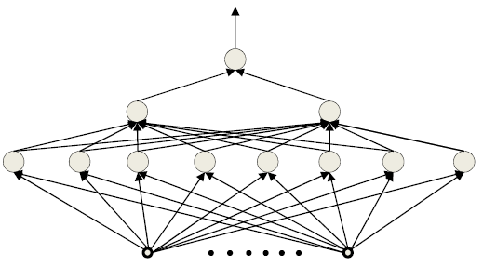
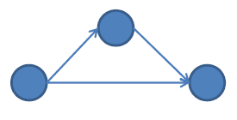
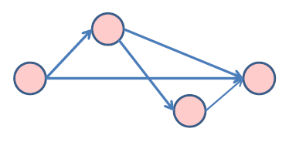
The Multi-Layer Perceptron (MLP)
A network of perceptrons is generally layered (layer 1 → layer 2 → layer 3, etc.)
“depth” in a network is the length of the longest path from a source to a sink
Inputs are real or Boolean stimuli
Outputs are real or Boolean values
Can have multiple outputs for a single input
“Deep” → Depth > 2
All middle layers are called hidden layers
Depth = 2
Depth = 3
Notes:
MLP can be referred to as one of the types of artificial neural networks.

Slide 13
Review of Boolean logic

Slide 14
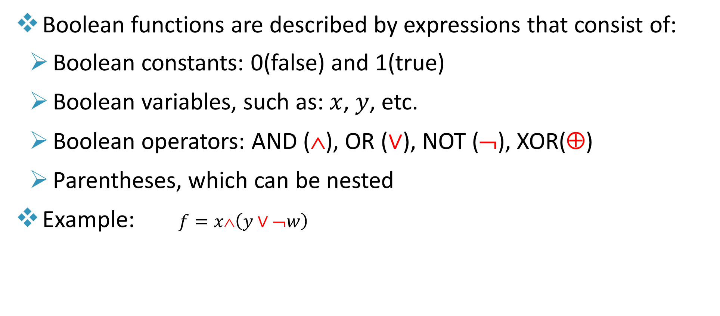
Boolean Functions
Boolean functions are described by expressions that consist of:
Boolean constants: 0(false) and 1(true)
Boolean variables, such as: $x$, $y$, etc.
Boolean operators: AND ($\text{}$), OR ($∨$), NOT (¬), XOR(⊕)
Parentheses, which can be nested
Example: $f=x\text{∧}\left(y∨\text{¬}w\right)$

Slide 15
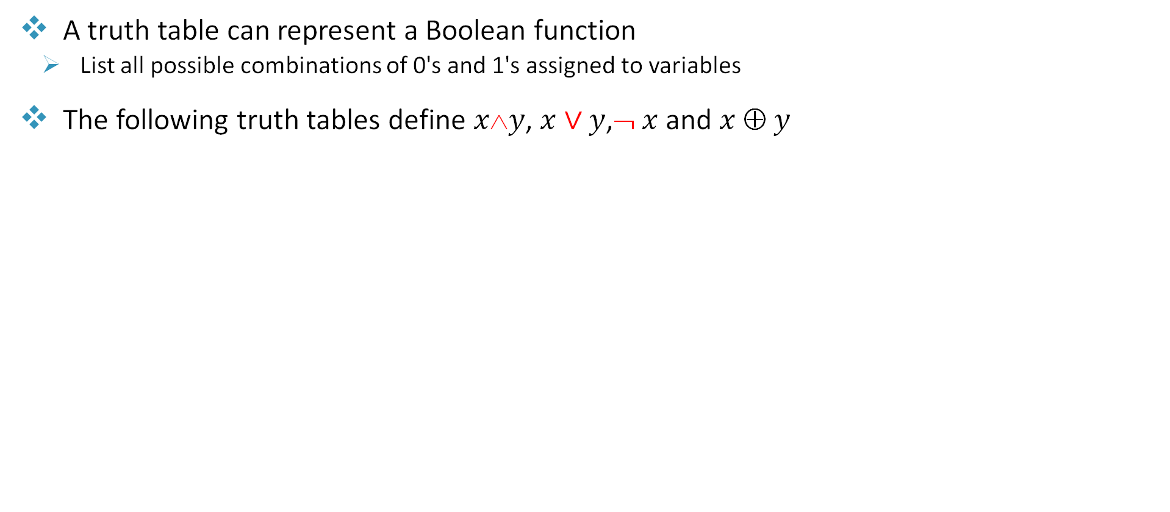
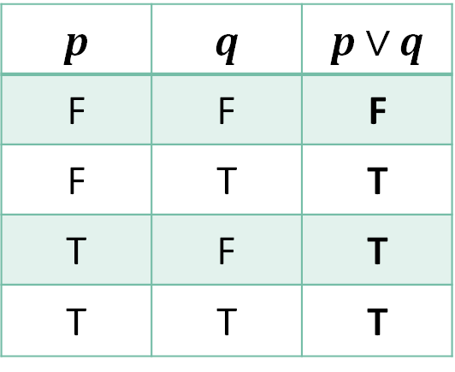
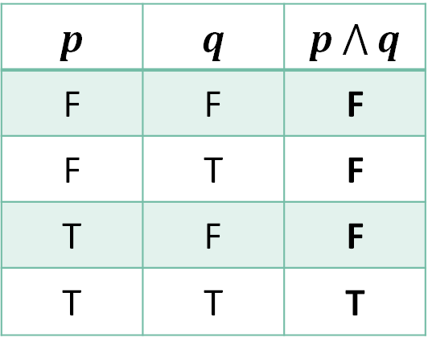
Truth Table
A truth table can represent a Boolean function
List all possible combinations of 0's and 1's assigned to variables
The following truth tables define $x\text{∧}y$, $x∨y$,¬ $x$and $x \text{⊕} y$
p | ¬p
F | T
T | F
p | q | p $⋀$ q
F | F | F
F | T | F
T | F | F
T | T | T
p | q | p$∨$ q
F | F | F
F | T | T
T | F | T
T | T | T
p | q | p ⊕ q
F | F | F
F | T | T
T | F | T
T | T | F

Slide 16
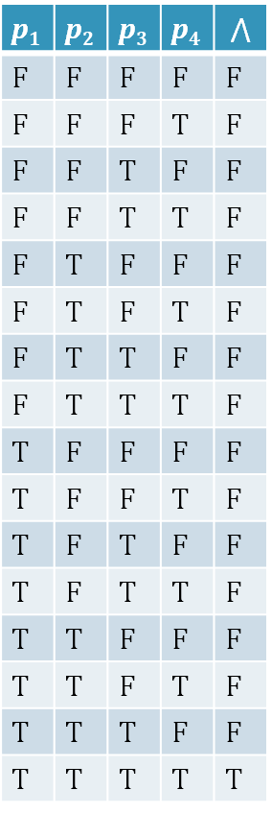
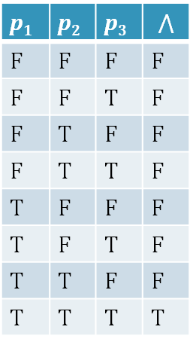
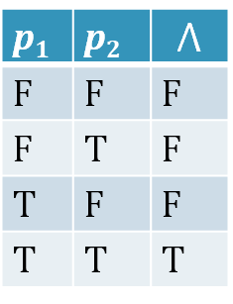
AND ($\text{}$) Truth Table Examples
p₁ | p₂ | p₃ | p₄ | $$⋀$$
F | F | F | F | F
F | F | F | T | F
F | F | T | F | F
F | F | T | T | F
F | T | F | F | F
F | T | F | T | F
F | T | T | F | F
F | T | T | T | F
T | F | F | F | F
T | F | F | T | F
T | F | T | F | F
T | F | T | T | F
T | T | F | F | F
T | T | F | T | F
T | T | T | F | F
T | T | T | T | T
p₁ | p₂ | p₃ | $$⋀$$
F | F | F | F
F | F | T | F
F | T | F | F
F | T | T | F
T | F | F | F
T | F | T | F
T | T | F | F
T | T | T | T
p₁ | p₂ | $$⋀$$
F | F | F
F | T | F
T | F | F
T | T | T
# rows = 2⁴ = 16
# rows = 2² = 4
# rows = 2³ = 8
Generally, # rows = 2^{n}, where n is the number of input variables

Slide 17
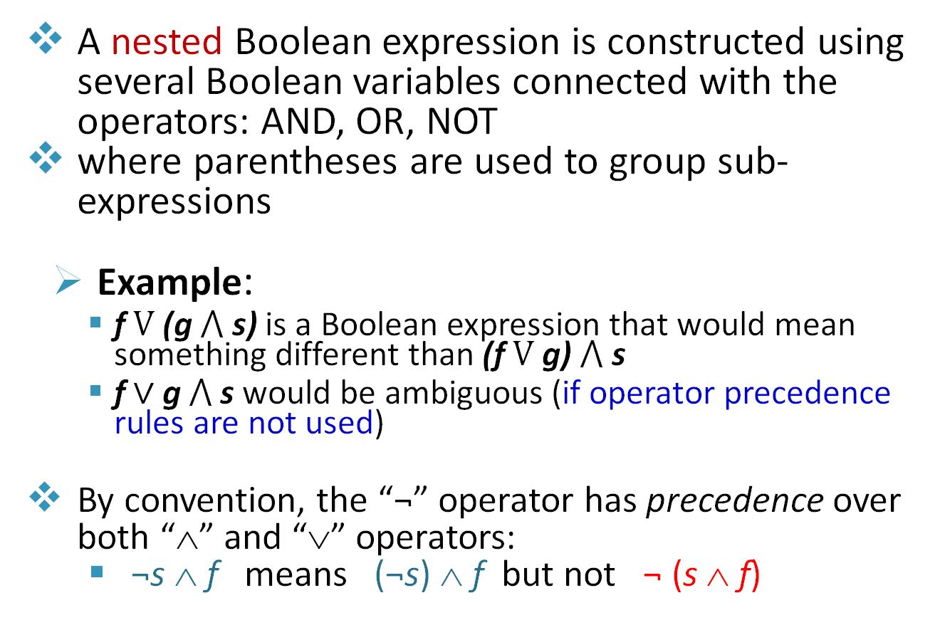
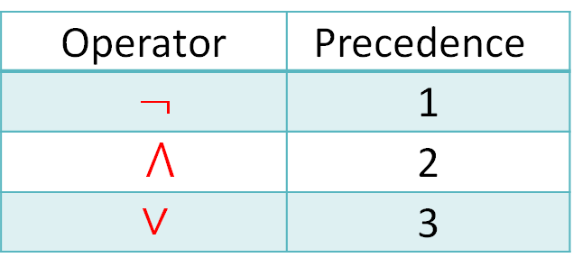
Nested Boolean Expressions
A nested Boolean expression is constructed using several Boolean variables connected with the operators: AND, OR, NOT
where parentheses are used to group sub-expressions
Example:
f $V$ (g $⋀$ s) is a Boolean expression that would mean something different than (f $V$ g) $⋀$ s
f ∨ g $⋀$ s would be ambiguous (if operator precedence rules are not used)
By convention, the “¬” operator has precedence over both “∧” and “∨” operators:
¬s ∧ f means (¬s) ∧ f but not ¬ (s ∧ f)
Operator | Precedence
¬ | 1
$⋀$ | 2
∨ | 3

Slide 18
De Morgan’s Laws
¬(p ∧ q) ≡ ¬p ∨ ¬q, [first law] ¬(p ∨ q) ≡ ¬p ∧ ¬q, [second law]
When applying De Morgan’s laws on compound propositional expressions, make sure to put brackets first around conjunctive operators
¬p ∨ ¬q ≡ ¬(p ∧ q) ¬p ∧ ¬q ≡ ¬(p ∨ q)
Proof: ¬(p ∨ q) ≡ ¬p ∧ ¬q
Example:
¬(p ∧ q V r ∧ s)
≡ ¬((p ∧ q) V (r ∧ s))
≡ ¬(p ∧ q) ∧ ¬ (r ∧ s)
≡ (¬p V ¬q) ∧ (¬r V ¬s)
p | q | ¬p | ¬q | (p ∨q)
F | F | T | T | F
F | T | T | F | T
T | F | F | T | T
T | T | F | F | T
¬(p ∨q)
T
F
F
F
¬p ∧¬q
T
F
F
F

Slide 19

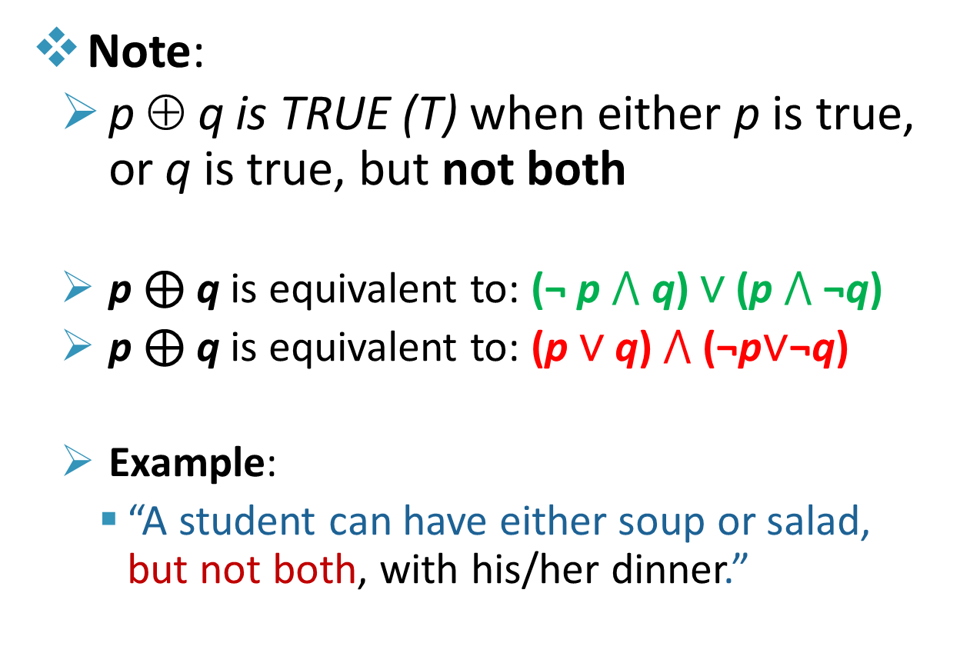
The Exclusive Disjunction Operator (XOR) “⊕” - Truth Table
Note:
p ⊕ q is TRUE (T) when either p is true, or q is true, but not both
p ⊕ q is equivalent to: (¬ p $⋀$ q) ∨ (p $⋀$ ¬q)
p ⊕ q is equivalent to: (p ∨ q) $⋀$ (¬p∨¬q)
Example:
“A student can have either soup or salad, but not both, with his/her dinner.”
p | q | p ⊕ q
F | F | F
F | T | T
T | F | T
T | T | F
Source: Why Neural Networks Are No Different To Logic Gates https://www.youtube.com/watch?v=tap1BLlKQxc

Slide 20
Application of MLP as Boolean Operators

Slide 21
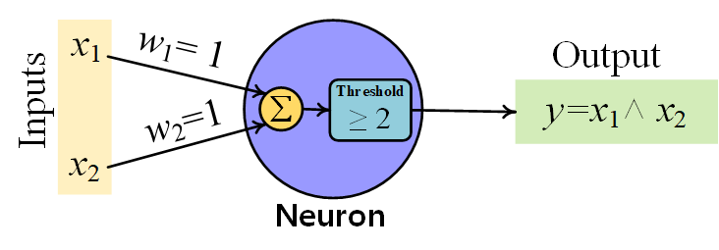
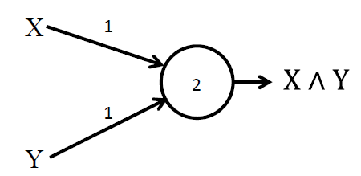
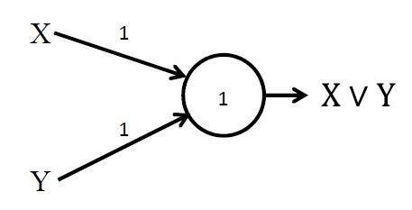
MLPs as Boolean Functions
The perceptron can mimic primitive Boolean gates
AND
OR
≡
≡

Slide 22
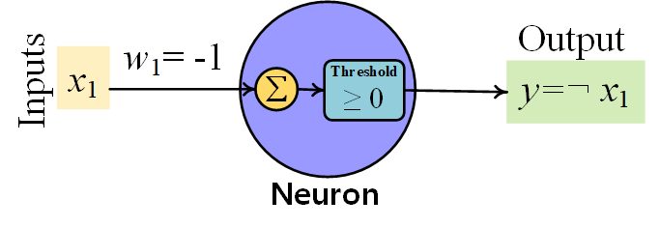
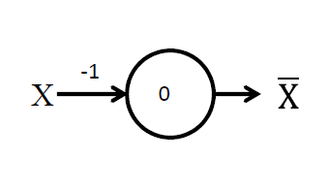
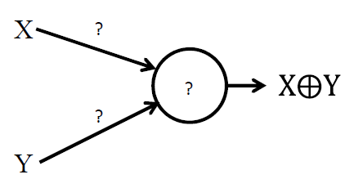
MLPs as Boolean Functions
The perceptron can mimic primitive Boolean gates
NOT
No solution for XOR gate using single perceptron!!
≡

Slide 23
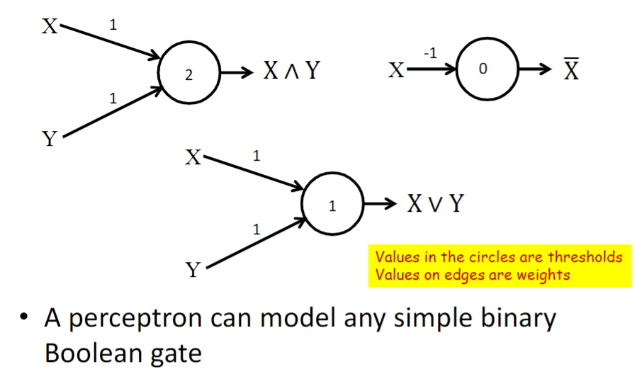
The perceptron as a Boolean gate

Slide 24
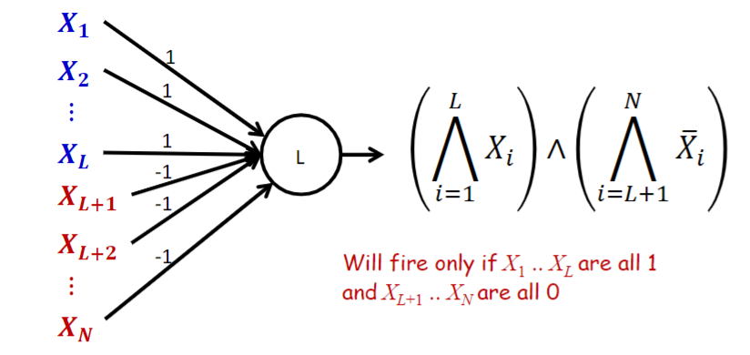
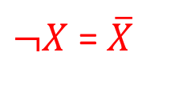
MLPs as Boolean Functions
MLPs can compute any Boolean function since they can emulate individual gates
L
X1
1
1
N-L
X2
2
-1
X3
Generalized AND gate
$¬X$ = $\overline{X}$
Threshold= L = # of non inverted inputs

Slide 25
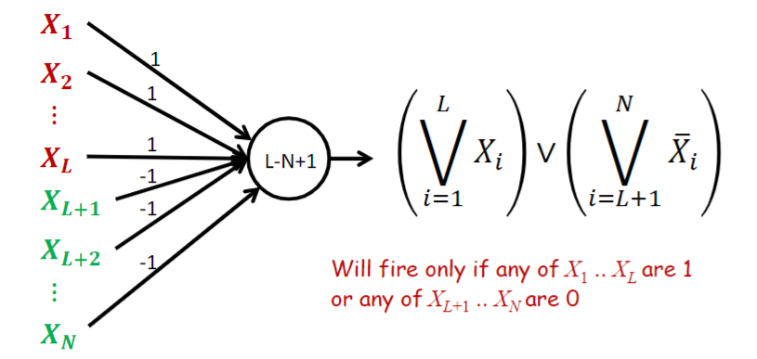

MLPs as Boolean Functions
MLPs can compute any Boolean function since they can emulate individual gates
X1X2X3
L
X1
1
1
N-L
X2
0
-1
X3
2-3+1=0
$¬X$ = $\overline{X}$
Generalized OR gate
Threshold=L-N+1 = 1 - # inverted inputs

Slide 26
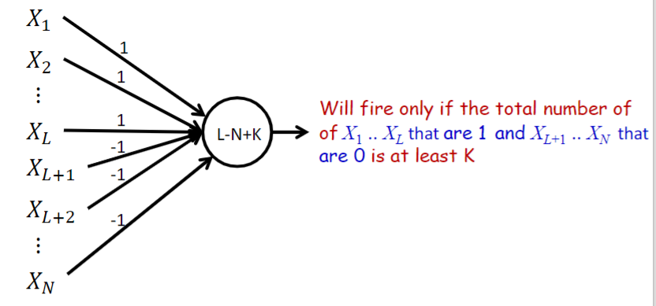
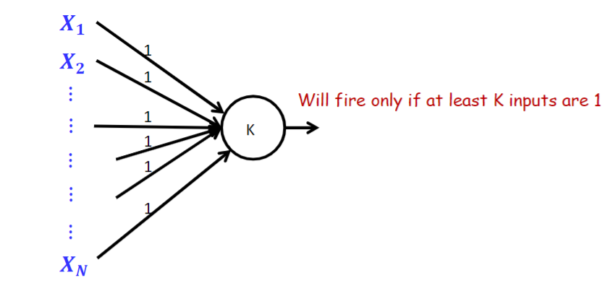
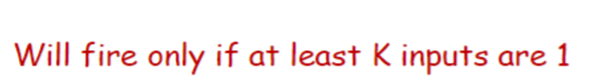
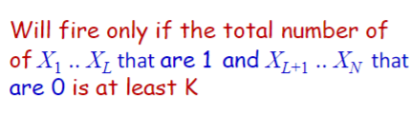
Perceptron as a Boolean Gate

Slide 27
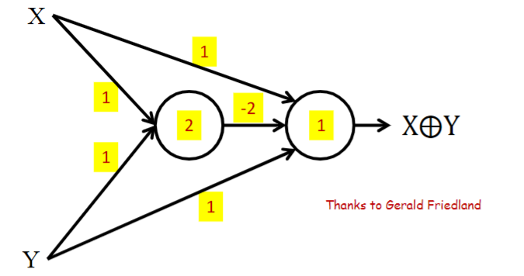
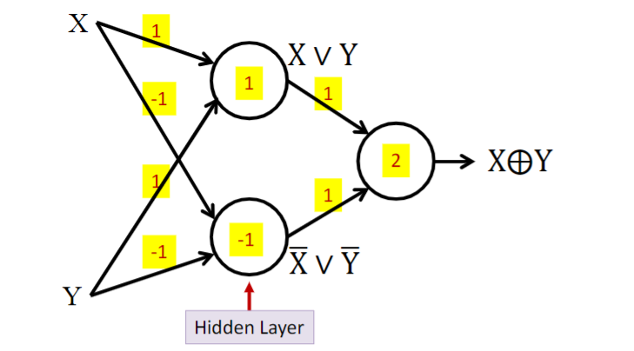
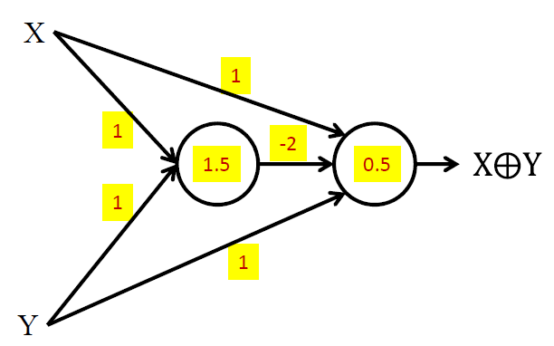
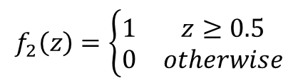
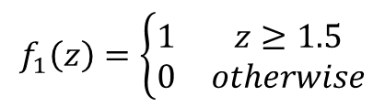
Multi-layer perceptron
Temp
$$f_{1}\left(z\right)=\left\{\begin{matrix}1 & z≥1.5 \\ 0 & otherwise\end{matrix}\right.$$
$$f_{2}\left(z\right)=\left\{\begin{matrix}1 & z≥0.5 \\ 0 & otherwise\end{matrix}\right.$$

Slide 28
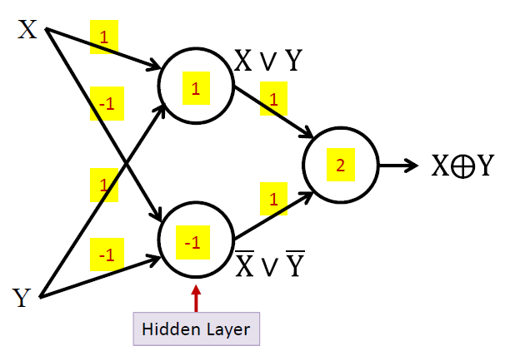
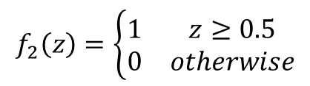
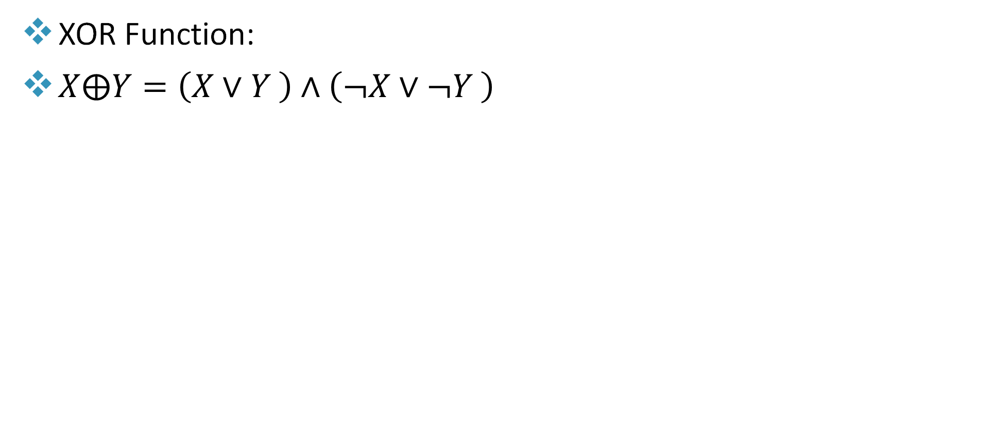
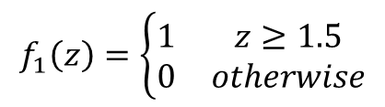
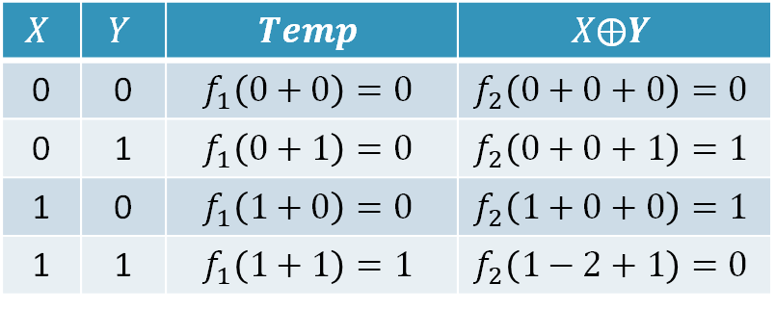
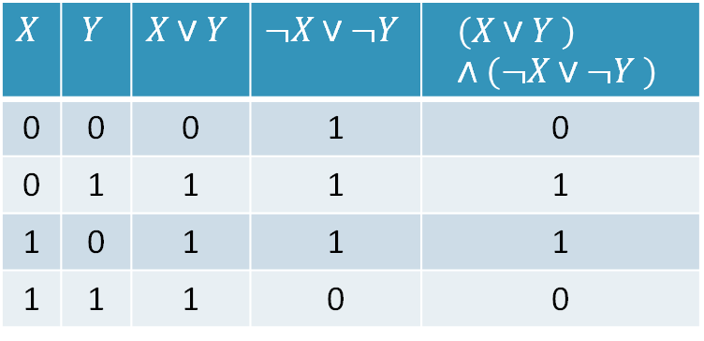
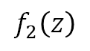
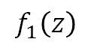
MLPs as Boolean Functions
$$X$$ | $$Y$$ | $$X∨Y$$ | $$¬X∨¬Y$$ | $$\left(X∨Y \right)∧\left(¬X∨¬Y \right)$$
0 | 0 | 0 | 1 | 0
0 | 1 | 1 | 1 | 1
1 | 0 | 1 | 1 | 1
1 | 1 | 1 | 0 | 0
XOR Function:
$X⨁Y=\left(X∨Y \right)∧\left(¬X∨¬Y \right)$
$$f_{1}\left(z\right)=\left\{\begin{matrix}1 & z≥1.5 \\ 0 & otherwise\end{matrix}\right.$$
Temp
$$f_{2}\left(z\right)=\left\{\begin{matrix}1 & z≥0.5 \\ 0 & otherwise\end{matrix}\right.$$
$$f_{1}\left(z\right)$$
$$f_{2}\left(z\right)$$
$$X$$ | $$Y$$ | $$Temp$$ | $$X⨁Y$$
0 | 0 | $$f_{1}\left(0+0\right)=0$$ | $$f_{2}\left(0+0+0\right)=0$$
0 | 1 | $$f_{1}\left(0+1\right)=0$$ | $$f_{2}\left(0+0+1\right)=1$$
1 | 0 | $$f_{1}\left(1+0\right)=0$$ | $$f_{2}\left(1+0+0\right)=1$$
1 | 1 | $$f_{1}\left(1+1\right)=1$$ | $$f_{2}\left(1−2+1\right)=0$$
XOR gate

Slide 29
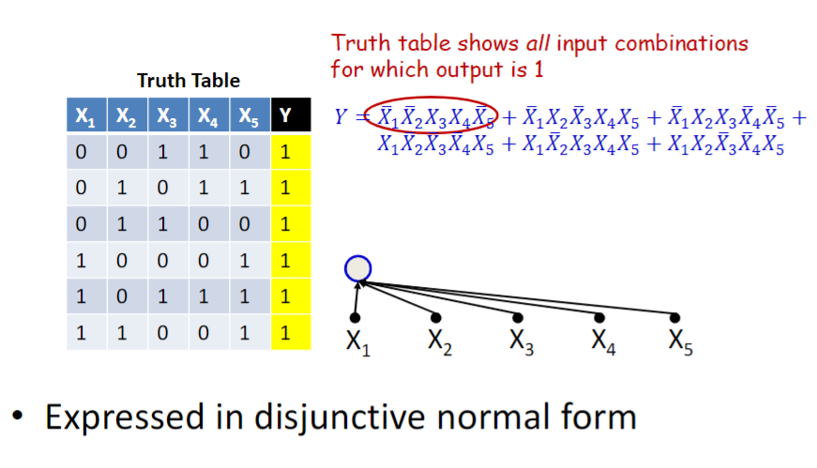
MLPs as Boolean Functions

Slide 30



MLPs as Boolean Functions
A one-hidden-layer MLP is a Universal Boolean Function
It can represent any function by expressing it in terms of the input conditions that make the function true
Hints:
In truth tables always look for output equal to “1”
The output Y is the sum of terms that have “1” in the truth table of Y
To represent a term in the output equation, put $¬X_{i}$ for all values of $X_{i}$ equal to zero and $X_{i}$ for all values that correspond to one
5-input variable ➔ Truth table has 2^5 = 32 rows; Only the rows with Y = 1 are shown.
Note:
$¬X$ = $\overline{X}$
$X_{1}∧X_{2}=X_{1}X_{2}$
$X_{1}∨X_{2}=X_{1}+X_{2}$

Slide 31



MLPs as Boolean Functions
Design a single hidden layer MLP to model the logical expression given below, assuming simple perceptron: $output = 1 if \sum_{i}{w_{i}x_{i}}+b≥0$. Clearly show the used weights and biases.
Note that bias = $−T$
$$Y=A∧B∧D∨¬C∧D$$
A | B | C | D | (h₁) | (h₂) | Y
0 | 0 | 0 | 0 | 0 | 0 | 0
1 | 1 | 0 | 0 | 0 | 0 | 0
1 | 1 | 1 | 1 | 1 | 0 | 1

Slide 32


Multi-layer perceptron
MLPs can compute more complex Boolean functions
MLPs are universal Boolean functions
Source: https://medium.com/data-science/what-the-hell-is-perceptron-626217814f53

Slide 33





Reducing a Boolean Function
Source: The Organic Chemistry Tutor (Introduction to Karnaugh Maps)
Notes:
Disjunctive Normal Form

Slide 34


MLPs as Boolean Functions – The XOR Function
Recall XOR implementation:
An XOR needs 3 perceptrons with 2 layers per XOR
XORing of $N$ variables – results in truth table of $2^{N−1}$ product terms (i.e. 1’s) that cannot be reduced.
The width of a single hidden-layer Boolean MLP with $N$ inputs requires $2^{N−1}$ perceptrons in hidden layer (Exponential in $N$)
Generally, deeper networks reduce the number of neurons (perceptrons) significantly
For an $N$ input XOR gate: $y=x_{1}⨁x_{2}⨁⋯⨁x_{N}$, total number of needed perceptrons (hidden plus output):
With one hidden layer: $2^{N−1}+1$ perceptrons
With $2\left(N−1\right)−1$ hidden Layers: $3(N−1)$ perceptrons
Example: $y=x_{1}⨁x_{2}⨁x_{3}⨁x_{4}⨁x_{5}⨁x_{6}$

Slide 35


MLPs as Boolean Functions – The XOR Function
Structure (1)
Summary:
Scheme 1: direct implementation from truth table
Scheme 2: using structure (1) and associative property
Scheme 3: using structure (2) and associative property
Structure (2)
Scheme/criteria | # of hidden layers | # of hidden layers + output | # of Perceptrons in hidden layers | Total # of Perceptrons
1 | 1 | 2 | $$2^{N−1}$$ | $$2^{N−1}+1$$
2 | $$2\left(N−1\right)−1$$ | $$2(N−1)$$ | $$3\left(N−1\right)−1$$ | $$3(N−1)$$
3* | $$2\left(N−1\right)−1$$ | $$2\left(N−1\right)$$ | $$2\left(N−1\right)−1$$ | $$2\left(N−1\right)$$
* ONE perceptron per layer for this scheme.
Example: $y=x_{1}⨁x_{2}⨁x_{3}⨁x_{4}⨁x_{5}⨁x_{6}$

Slide 36
MLPs as Boolean Functions
An MLP can represent a given function only if it is sufficiently wide and sufficiently deep
A network with fewer than the minimum required number of neurons cannot model the function
Optimal width and depth depend on the number of variables and the complexity of the Boolean function
Deeper networks may require far fewer neurons than shallower networks to express the same function
The actual number of parameters in a network is the number of connections
Networks that require an exponential number of neurons will require an exponential number of weights

Slide 37


MLPs as Universal Classifiers
The “real”-valued perceptron
Inputs and weights are real values
Output could be Boolean or real
Any real-valued “activation” function may operate on the weighted sum input
MLP as a function over real inputs finds a complex “decision boundary” over a space of reals
28x28 image

Slide 38





MLPs as Universal Classifiers
A perceptron operating on real-valued vectors is a linear classifier
Boolean perceptrons are also linear classifiers
If we have n inputs, the weights define a decision boundary that is an $n–1$ dimensional hyperplane
$$−T+w_{1}x_{1}+w_{2}x_{2}≥0$$
$$x_{2} ≥ −\frac{w_{1}}{w_{2}}x_{1} +\frac{T}{w_{2}}$$
X OR Y
X XOR Y

Slide 39

What is a layer?

Slide 40


MLPs as Universal Classifiers
Assuming the use of a single simple perceptron: $output = 1 if \sum_{i}{w_{i}x_{i}}+b≥0$. Clearly show the used weights and biases that detect the decision boundary below the given blue line (i.e., output =1 for area under the blue line).
Line passes through (-1, 0) and (0, -2)
Equation of the line $x_{2}=−2x_{1}−2$
Thus, the decision boundary is $x_{2}≤−2x_{1}−2$
➔ $−{2x}_{1}−x_{2}−2≥0$
Thus: $w_{1}=−2,w_{2}=−1,\text{and} b=−2$
i.e. $W =\left(w_{1},w_{2}\right)=(−2, −1)$

Slide 41





Composing Complex “Decision” Boundaries
Build a MLP network with a single output that fires if the input is in the colored area
The network must fire if the input is in the colored area

Slide 42



Composing Complex “Decision” Boundaries
What shape do we get if we compare the sum of the hidden outputs to 4?

Slide 43

Composing Complex “Decision” Boundaries
MLPs can compose arbitrarily complex decision boundaries

Slide 44








Composing Complex “Decision” Boundaries
Design an MLP to classify the decision boundary given below, assuming simple perceptron: $output = 1 if \sum_{i}{w_{i}x_{i}}+b_{i}≥0$. Clearly show the used weights and biases.
$x_{2}=x_{1}+1$, then
Yellow region iff $x_{2}≤x_{1}+1$
Or ${−x}_{2}+x_{1}+1≥0$
$x_{2}=−x_{1}+1$, then
Yellow region iff $x_{2}≤−x_{1}+1$
Or ${−x}_{2}−x_{1}+1≥0$
$x_{2}=x_{1}−1$, then
Yellow region iff $x_{2}≥x_{1}−1$
Or $x_{2}−x_{1}+1≥0$
Why is this bias equal to $−4$?
Ans: We are ANDING the results from the hidden layer perceptrons ➔ Threshold should be $4$ or bias = -ve of Threshold = $−4$
$x_{2}={−x}_{1}−1$, then
Yellow region iff $x_{2}≥−x_{1}−1$
Or $x_{2}+x_{1}+1≥0$

Slide 45

Example 2:
Design an MLP to classify the decision boundary shown on the right, assuming simple perceptron: $output = 1 if \sum_{i}{w_{i}x_{i}}+b_{i}≥0$. Clearly show the used weights and biases. Note the decision boundary is Region 1 UNION Region 2.
SOLUTION:
Region 1:
Line 1: x1=0 ➔ Region: x1>=0 ➔ (1)x1 + (0) x2>= 0
Line 2: x2=0 ➔ Region: x2>=0 ➔ (0)x1 + (1)x2 >= 0
Need an AND gate to confine the output to Region 1
Region 2:
Line 3: x1=0 ➔ Region: x1<=0 ➔ (-1)x1 + (0)x2 >= 0
Line 4: x2=0 ➔ Region: x2<= 0 ➔ (0)x1 + (-1)x2 >=0
Need an AND gate to confine the output to Region 2
Need an OR gate to combine Region 1 and Region 2
Number of needed perceptrons: 3+3+1 = 7

Slide 46

Example 3
Design an MLP that classifies all points in the highlighted in Fig.1 as 1, and all other points as 0.
The highlighted area includes all points to the right of the line X1=−3, EXCLUDING those in the fourth quadrant.
This can NOT be done using 2 layers MLP
You can divide the area into two regions: region1 and region2.
The two regions in fig2 will be implemented using 3 layers with 8 perceptrons.
You can do better (less perceptrons) by the dividing the designated area as in fig. 3.
This can be implemented using 3 layers with 7 perceptrons.
Region-1
Region-2
Region-1

Slide 47


Example 3 – cont’d
Line
X1=-3
Considering the 2 common lines in Fig 2: line1 and X1 axis, that will save us 2 perceptrons.
Region-1 is defined by two boundaries: X1 = -3 and X2 = 0
That makes the region:
X1 + 3 ≥ 0 AND X2 ≥ 0
Region-2 is defined by three boundaries X1 = -3 , X2 = 0 , and X1 = 0
That makes the region:
X1 + 3 ≥ 0 AND - X2 ≥ 0 AND -X1 ≥ 0
The MLP with 6 neurons that does the required job :
Line
X1=0
Line
X2=0
Fig. 2
0
0

Slide 48
Example 3 – cont’d
Line
X1=-3
Line
X1=0
Note that if we use Regions division as in Fig 4 on previous slide:
Then Region-2 can be defined using two boundaries (instead of 3): X1=-3 and X1=0.
In this case, Region-1 and Region-2 overlap, but that is NOT a problem for the final OR operation.
Then the connection/weight highlighted in RED is NOT needed
You still need 6 neurons defined the desired boundary.
Region-1
Region-2
Line
X2=0
Fig. 4
0
0

Slide 49
Acknowledgments
Slides have been used from:
https://www.cs.cmu.edu/~bhiksha/courses/deeplearning/Spring.2019/www/
https://deeplearning.cs.cmu.edu/F25/document/slides/lec2.universal.pdf

